Slide 1
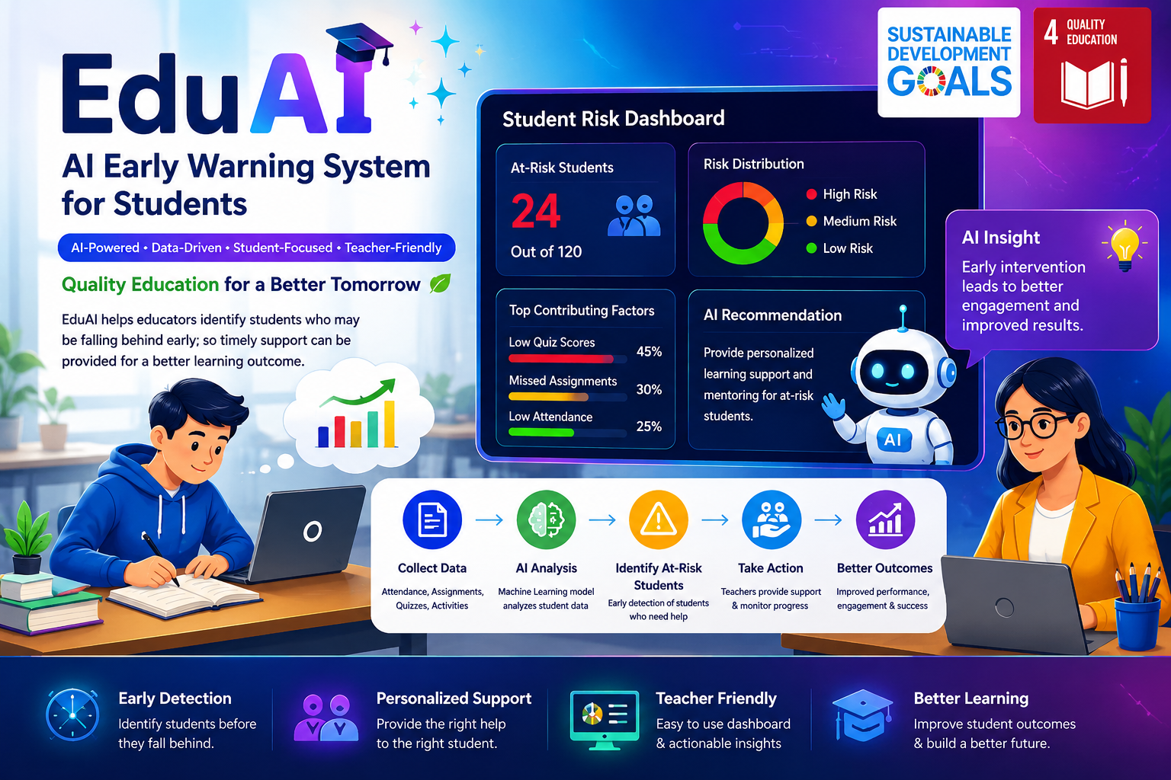
EduAI- AI-Powered Early Warning And Academic Support System.
SDG- 4- Quality Education

Slide 2
PROJECT TITLE: EduAI- AI -Powered Early Warning And Academic Support System
NAME: Durga Prasad Annamdevula
COURSE: BCA
COLLEGE NAME: Aditya Degree College Rajamahendravaram
Adikavi Nannayya University
AICTE EMAIL- ID: durgaprasadannamdevula41@gmail.com
INTERNSHIP NAME: 1M1B AI for Sustainability Virtual Internship
COLLABORATION: IBM SkillsBuild And AICTE
SDG: SDG 4- Quality Education

Slide 3
Project Description:
EduAI is an AI-powered solution focused on Quality Education
(SDG-4).
It identifies students who are falling behind in their studies at an early stage.
AI analyzes student academic information to identify students who may need support.
It helps teachers provide timely and personalized academic guidance.

Slide 4
SDG Alignment:
Primary SDG 4 – Quality Education
Identifies students at risk of falling behind in their studies.
Enables early academic intervention and support.
Provides personalized learning guidance.
Helps improve student learning outcomes.
Supports inclusive and equitable quality education.

Slide 5
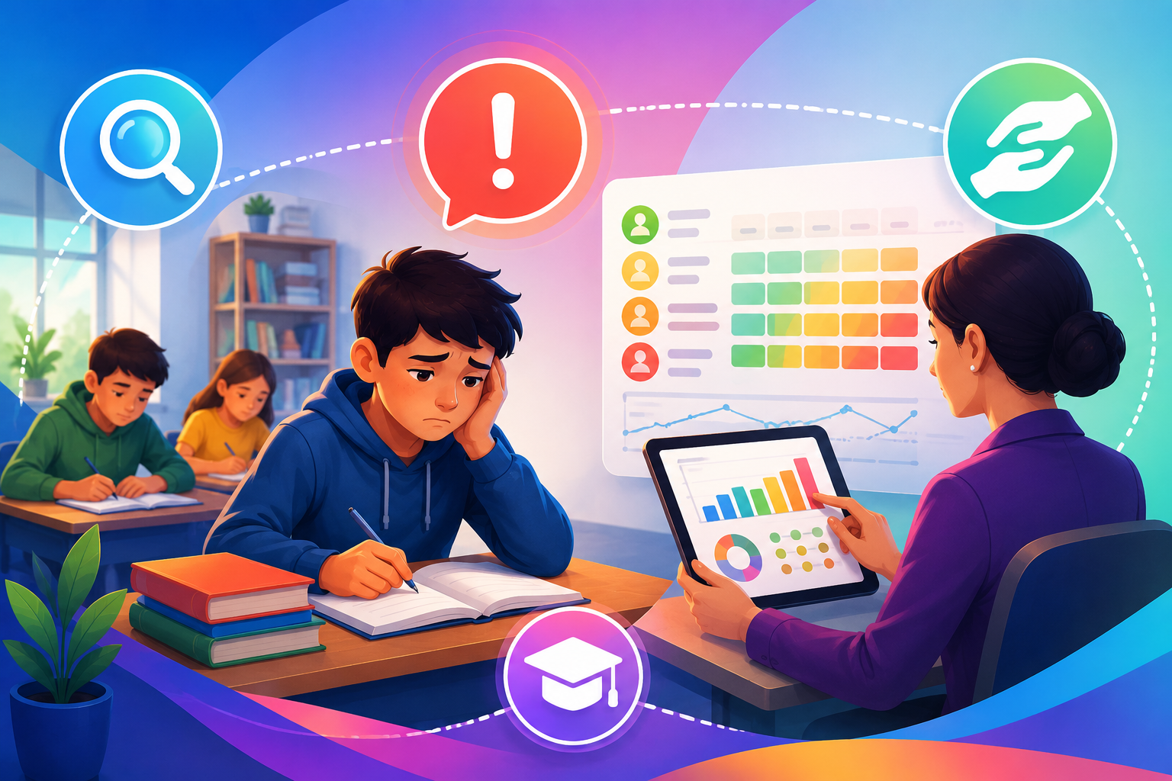
Problem Statement
Identifying Students Who Are Falling Behind In Their Studies At An Early Stage.
Late Identification May Delay The Academic Support They Need.
How might we use AI to identify students who are falling behind in their studies at an early stage so that timely academic support can be provided?

Slide 6
AI Solution Overview
EduAI uses Artificial Intelligence to analyze student academic information.
It identifies students who may be falling behind in their studies at an early stage.
AI detects patterns that may indicate a need for academic support.
It provides early risk identification and support recommendations.
This helps teachers take timely and personalized academic action.

Slide 7
Target Users
👩‍🏫 Teachers & Educators – Early identification of at-risk students.
🏫 Schools & Educational Institutions – Monitoring academic performance.
👨‍🎓 Students – Timely academic support and personalized recommendations.

Slide 8
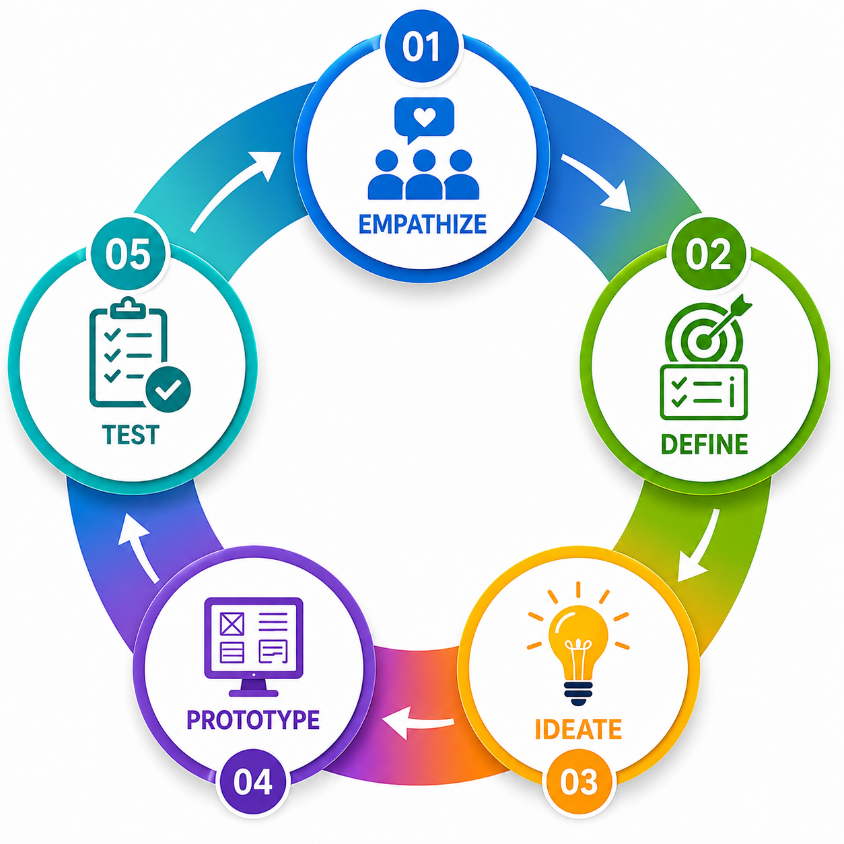
Design Thinking Process
Empathize
Understand students' learning challenges and teachers' monitoring difficulties.
Define
Identify students who may be falling behind and need timely support.
Ideate
Develop an AI-based early warning system to predict student risk levels.

Slide 9
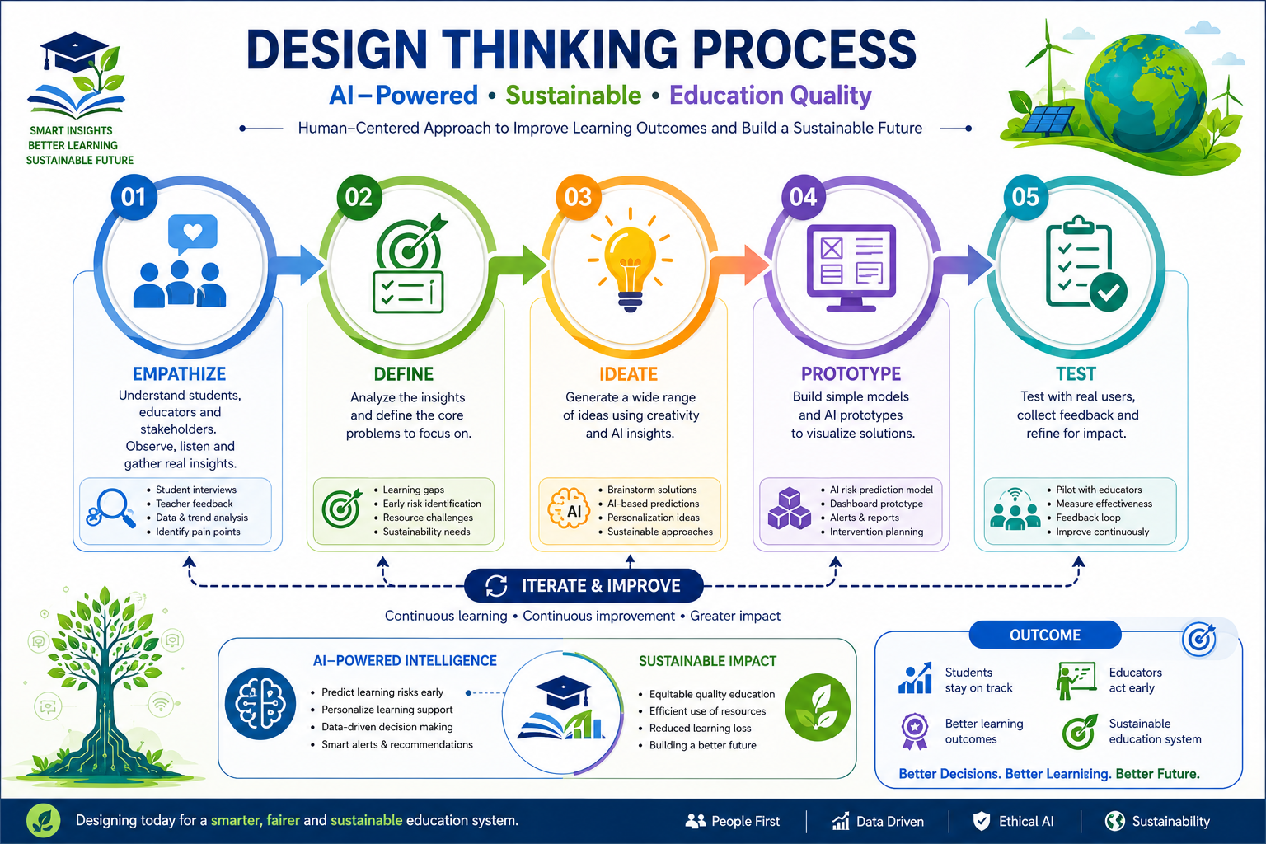
Prototype
Create the EduAI prototype with risk classification and personalized recommendations.
Test & Refine
Test the prototype with synthetic data and improve it based on results and feedback.

Slide 10
AI Technology Used
IBM BOB – Prototype Development.
IBM Granite 4.0 H Small- Generative AI.
IBM watsonx.ai - AI Model Integration.
Scikit-Learn (Random Forest) – Machine Learning And Risk Classification.
Prompt Engineering - AI Interaction And Guidance.

Slide 11
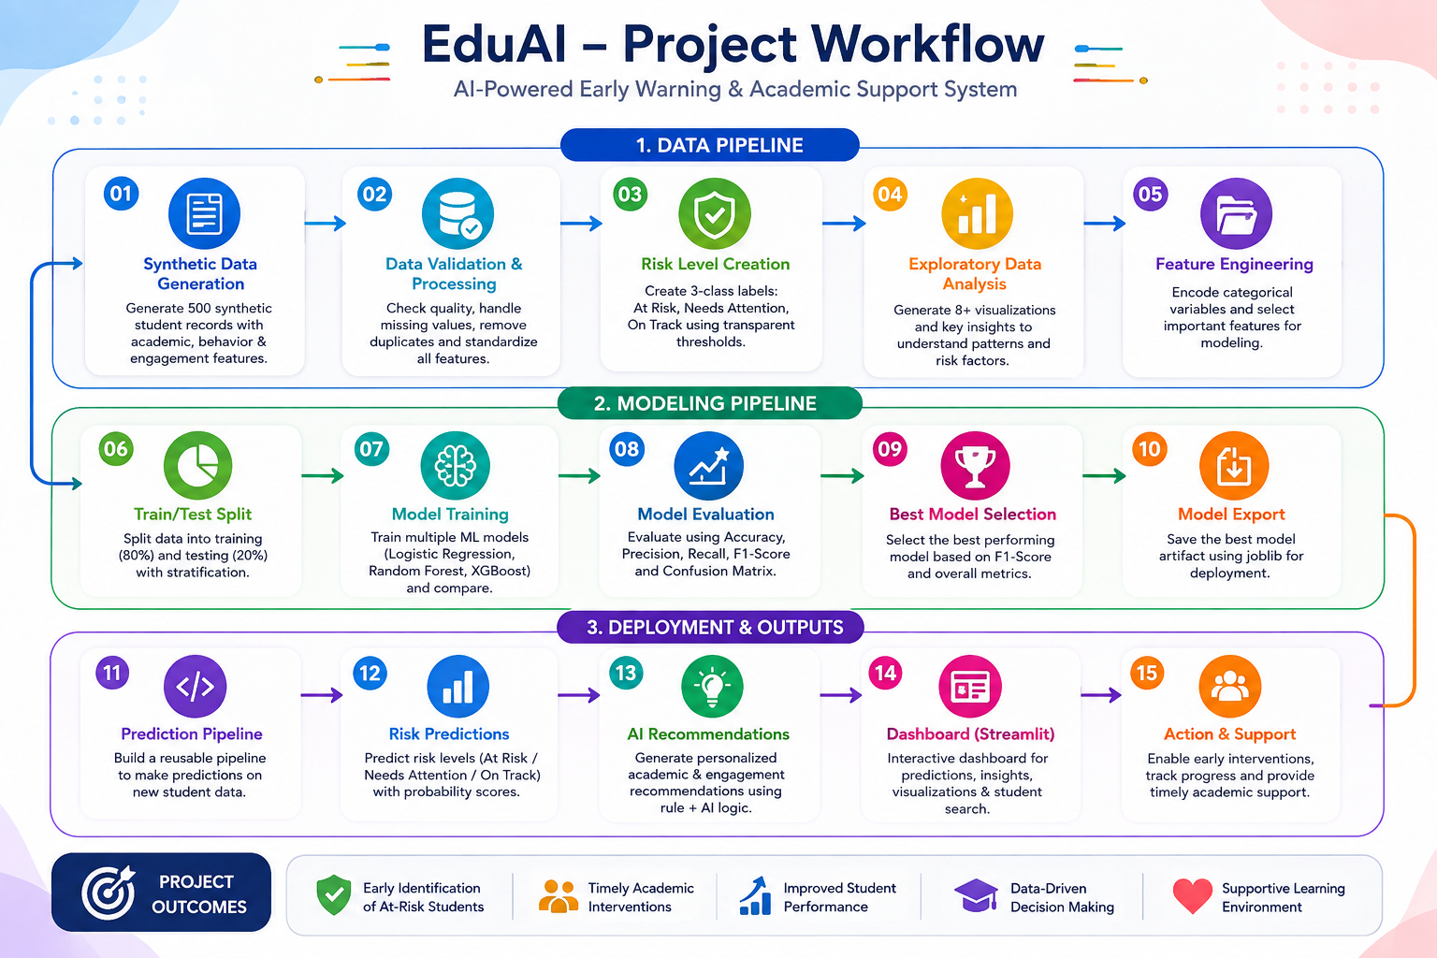
Project Workflow

Slide 12
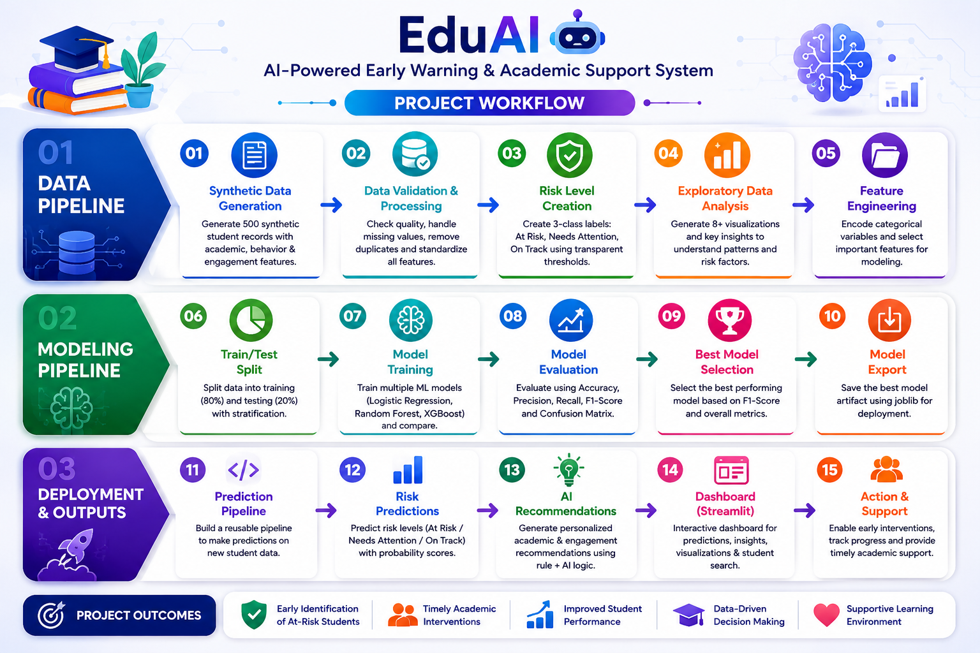
AI Workflow

Slide 13
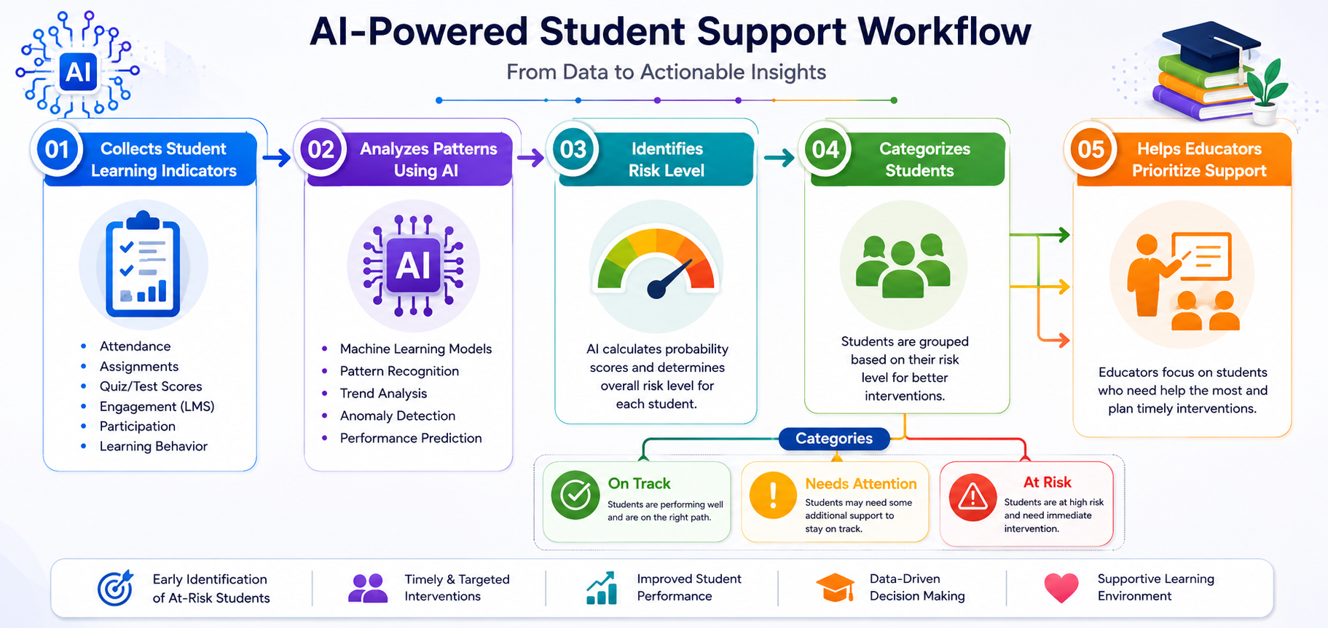

Slide 14
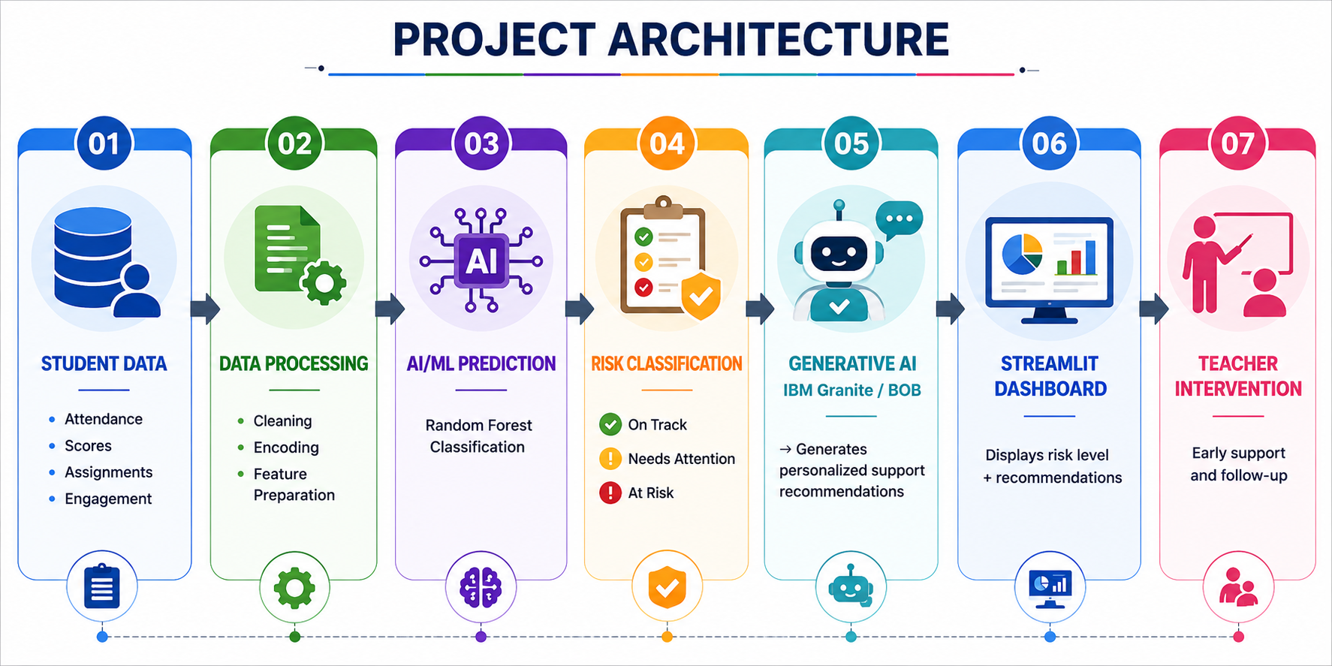
Project Architecture

Slide 15
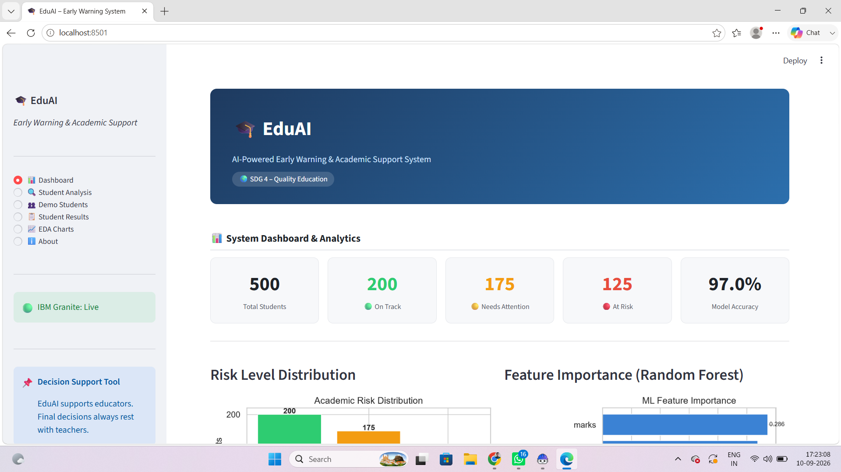
Prototype

Slide 16
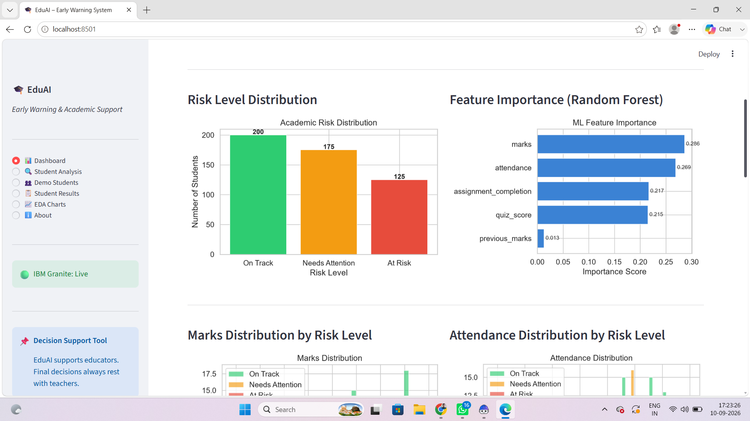

Slide 17
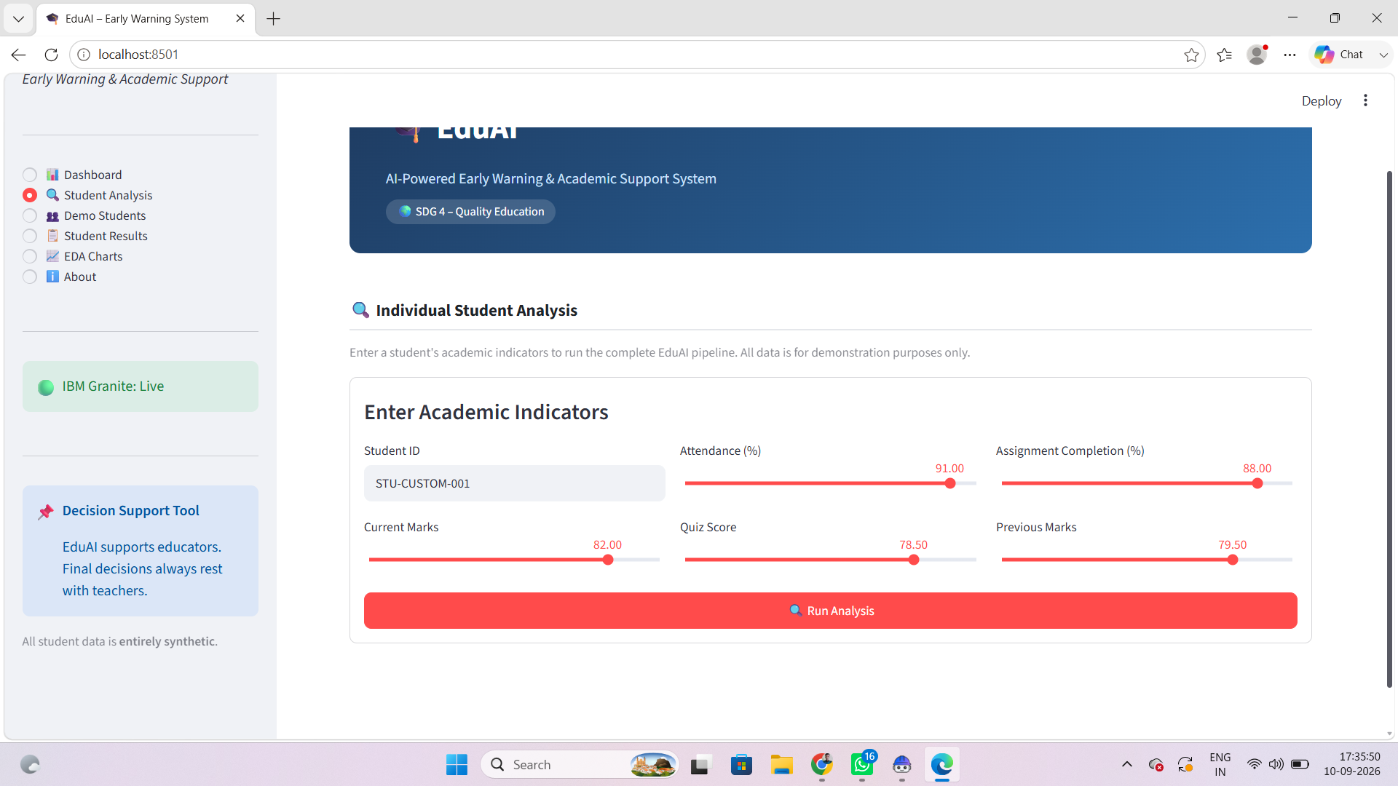

Slide 18
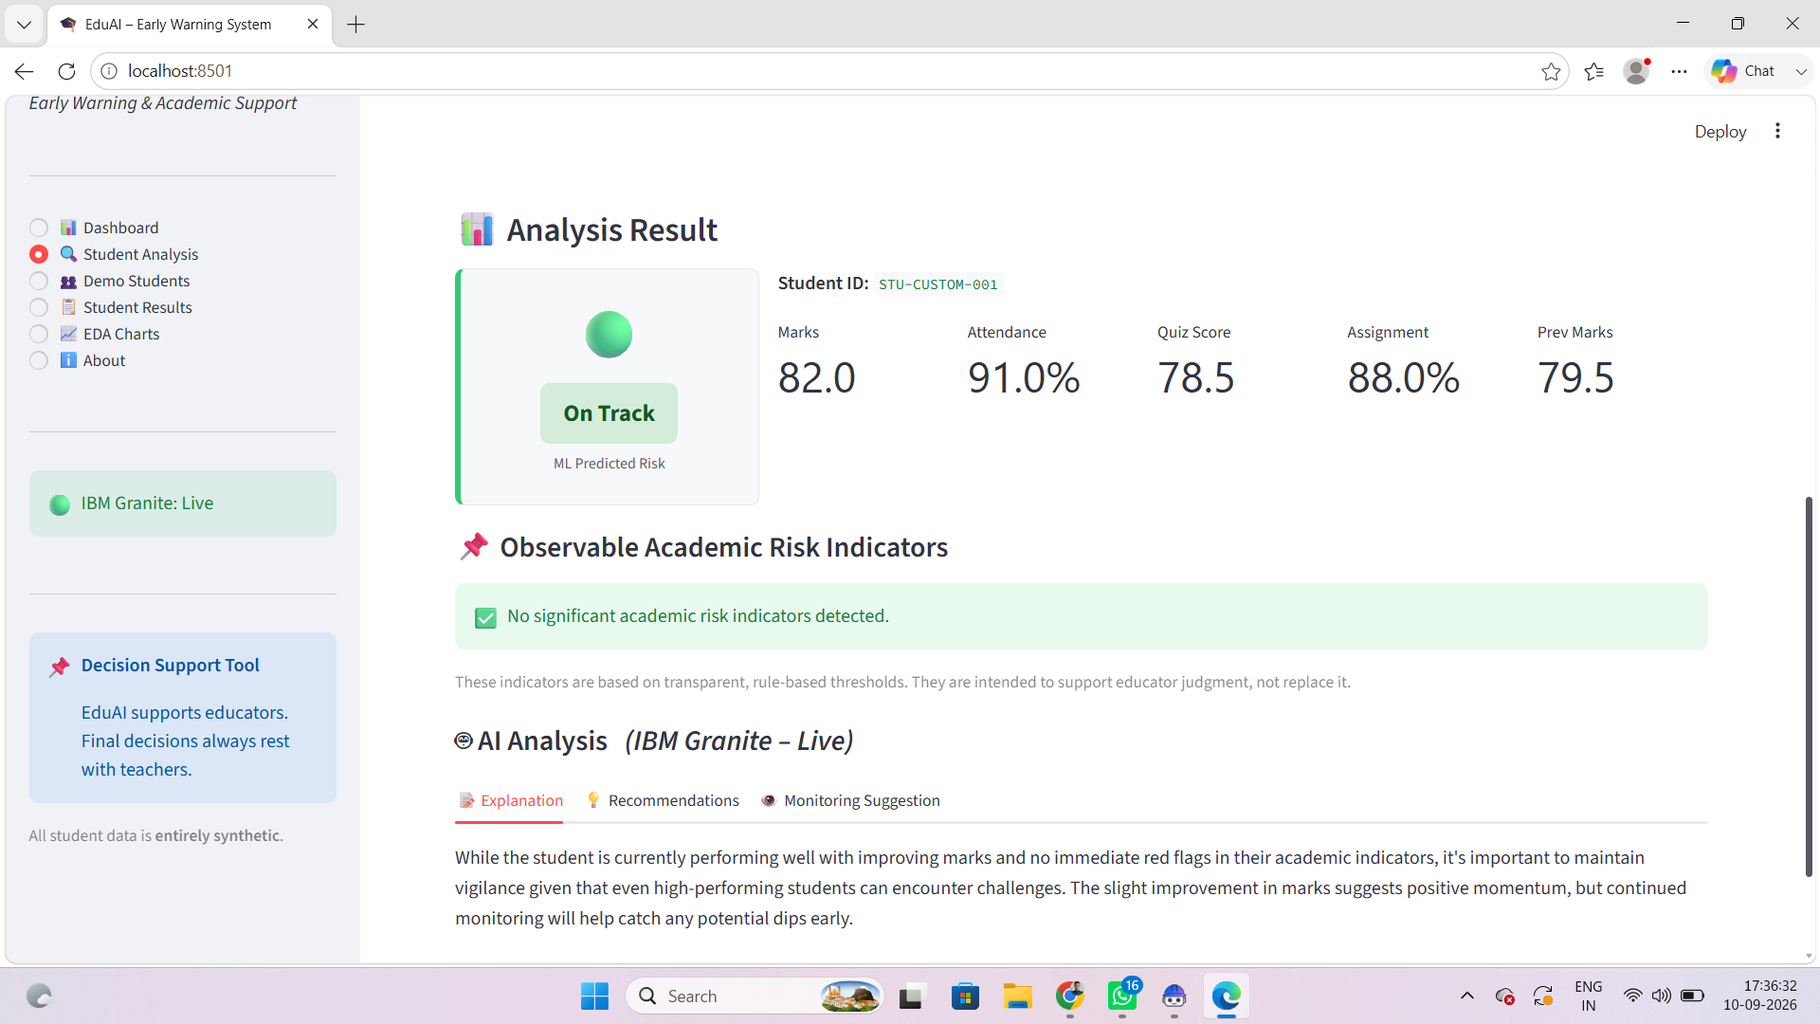

Slide 19
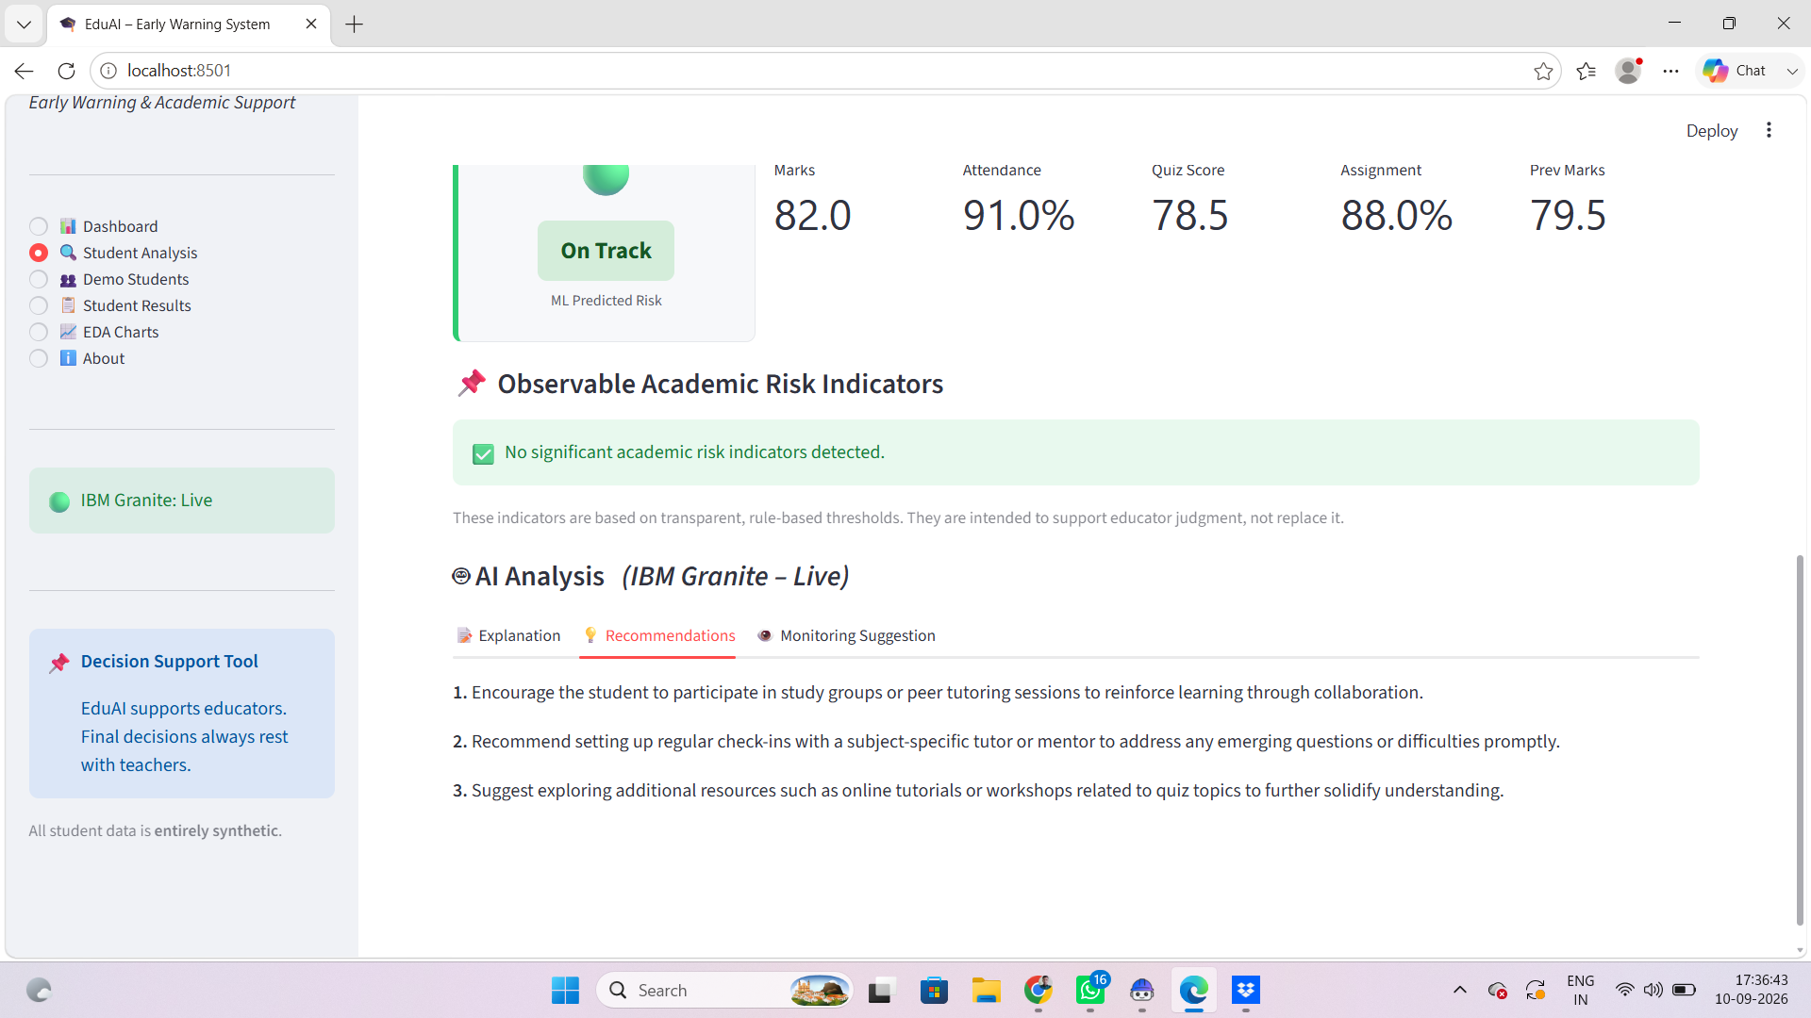

Slide 20
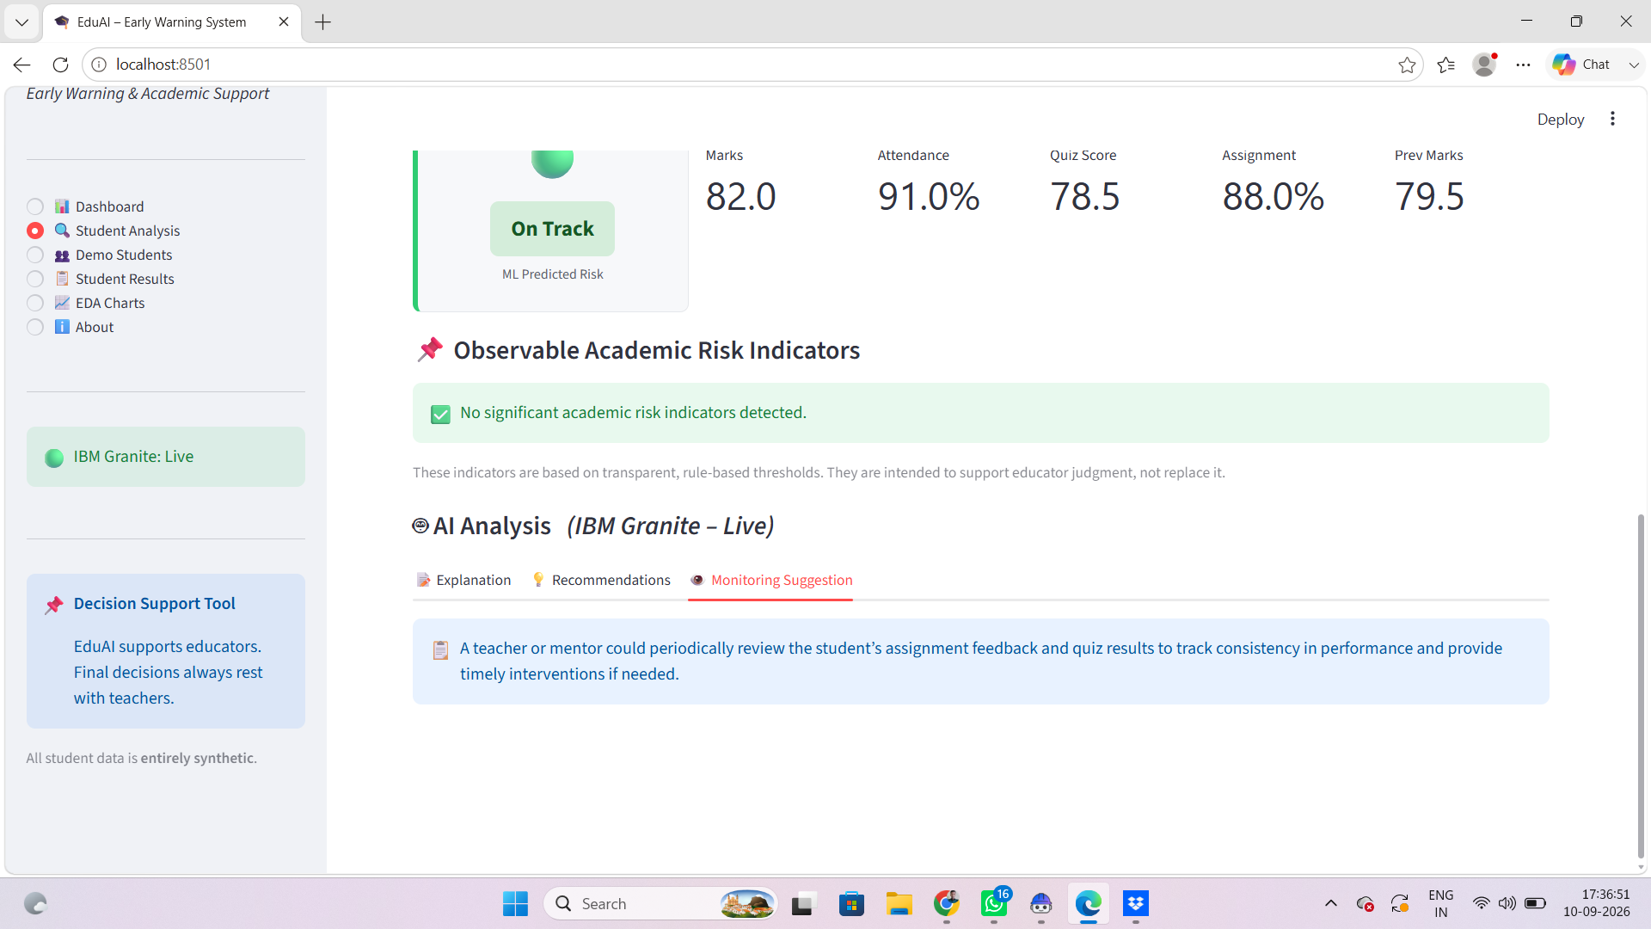

Slide 21
Responsible AI Considerations
Fairness :
Student risk predictions should be free from unfair bias.
Different backgrounds or learning conditions should not unfairly affect predictions.
Transparency :
The system should clearly communicate why a student is identified as On Track, Needs Attention, or At Risk.
Teachers should be able to understand and review AI-generated recommendations.

Slide 22
Privacy:
Protect students' academic and personal information.
Use only necessary data and avoid exposing sensitive student details.
Ethics:
AI should support teachers, not replace human judgment.
Predictions should not be used to label, punish, or discriminate against students.
Final intervention decisions should involve teachers/mentors.

Slide 23
Expected Impact
Early Identification:
Identify students who may be falling behind at an early stage.
Timely Support:
Help teachers provide timely support to students who need attention.
Reduced Learning Gaps:
Support students in overcoming learning difficulties and gaps.
Improved Learning Outcomes:
Contribute to better academic performance and student success.
Inclusive & Sustainable Education:
Promote equal learning opportunities and contribute to a more inclusive and sustainable education system.

Slide 24
Impact Statement
Early Support:
Students receive support before learning gaps become larger.
Better Teaching Decisions:
Teachers can focus on students who need additional attention.
Reduced Learning Gaps:
Early intervention can help improve student learning outcomes.
Inclusive Education:
Students get more equal opportunities to succeed.
Sustainable Education:
Supports a more inclusive, equitable, and sustainable education system.

Slide 25

Conclusion
Helps identify students who need support at an early stage.
Supports teachers in making better academic decisions.
Provides personalized recommendations using AI.
Helps reduce learning gaps and improve student outcomes.
Contributes to inclusive, equitable, and sustainable education.

Slide 26
Github Link
https://github.com/Annamdevula1/Quality-Education-SDG-4-Project.git

Slide 27

" THANK YOU "

